Slide 1


SEICHE 2022 Basic Arduino Programming
Instructor: Paul Frommeyer
www.paulfrommeyer.com
Corporate Sponsor: DXC Technology

Slide 2
Lesson Plan Overview
Lesson 5 – Binary Images, Arrays, Characters, Strings, Loops
Loading Binary Images
Arrays
Characters and Character Codes
Strings
Conditional Loops Part 1
Lesson 6 – Loops (cont.), LED Matrix Displays, Nested Loops Advanced Functions, Binary Numbers Part 1
For-Next Loops
SPI Peripherals
Using a MAX7219 LED Matrix Display
Lighting and clearing individual pixels
Advanced Functions
Nested Loops
Lesson 7 – The Binary Number System (may take 2 lessons)
Numerals vs numbers
Review: the base 10 system and digit place values
New: the base 2 system and digit place values
Bits and bytes and nybbles
Binary addition and subtraction
Lesson 8 – Producing Sound
Formatting printed output in Serial Monitor
Shifting and exponents
Bitwise operations and masking
Displaying text on the LED matrix display
Review of sound wave theory
Analog vs Pulse Width Modulation
Producing sound tones with an Arduino microcontroller
Lesson 9 – Reading Analog and Digital pins
Millis
Reading buttons
Debouncing buttons
Reading analog values from a potentiometer
Lesson 10 – The I2C Bus and Peripherals
I2C Bus Operation
Initializing the I2C bus
Accessing an I2C temperature sensor
Real Time Clocks
Accessing a DS3231 RTC
Lesson 11 – NTP and Text Management
Numeric to ASCII Conversions
Time representations and conversions
Network Time Protocol
Displaying the time on an LED matrix display
Lesson 12 – Text Management
sprintf revisited
Text Effects
Changing the default font
Using multiple display zones
Lesson 1 – Intro and Setup [may require 2 classes]
Introduction to class format
Overview of lesson plan
Presentation format (monitor, camera, screen, whiteboard)
Review of microcontrollers and types of boards
SEICHE LED display architecture
ESP8266 pinout
High level architecture
Lesson 2 – Laptop operation review – Windows and Linux
Inventory of USB drives
Installation of Arduino IDE software
Installation of CH340/ESP8266 serial port drivers (Windows only)
Control panel/settings location
Home directories and folder hierarchy
Arduino file locations
Search functions
(Windows) Device Manager
(Linux) Konsole
Copying flash drive contents [critical]
Open questions and issues
IDE essentials
Starting the Arduino IDE
Basic Arduino sketch (program) structure
Loading example sketches
Loading and configuring new boards
Connecting boards
Identifying the microcontroller serial port
Linux
Windows
Lesson 3 – Libraries, Sketch structure, Serial Monitor, Variables, Binary Number System Pt1
Libraries
Sketch structure (A note on brace formatting)
The serial port monitor
Printing to the serial port monitor
Variables and the assignment operator
Binary number system Pt. 1.
Lesson 4 – Expressions, Conditionals, Blocks and Functions
Arithmetic Expressions and Operators
Incrementing and Decrementing Variables
Truth Values in C++
The If-Then Statement
Code Blocks
Functions

Slide 3
Lesson 12 – sprintf redux, Text Effects, Changing Fonts, Multiple Display Zones
Class Exercise - sprintf() redux
Class Exercise - Text Effects
Introduction to fonts – bitmap fonts
Including supplemental code with #include
Classroom Exercise – Using Different Fonts
MD_Parola Display Zones
Classroom Exercise – Using multiple display zones

Slide 4
sprintf() Redux
Below is an example of how sprintf() can be used in actual code
void setup()
{
Serial.begin(9600);
sprintf(buffer,”%i @@ %c @@ %d @@ %f @@ %e @@ %u @@ %s”, i, c, d, f, u, sometext);
Serial.println(buffer);
}
CLASSROOM EXCERCISE
Load Sketch 12A into your displays
Now, modify the sprintf statement in the sketch to do the following:
Display a byte along with a string (text of your choice)
Display an integer with at least three leading zeros
Display a float with two decimals of precision
Display a float in exponential notation
Display all of the above together (you may need to change the character buffer size to handle all of the output)
Note: sprintf format reference can be found at the end of the presentation

Slide 5
Class Exercise – Text Effects
The MD_Parola library offers a number of text effects that can be used to put text on the display and then remove it
The effect used when displaying text is called the entry effect
The effect used when removing text is called the exit effect
You can see these in your code, they are PA_LEFT, PA_LEFT
Below is a list of just some of the Parola entry and exit effects; they can be used symmetrically or in any combination
Try them out!
The full list can be found here: https://majicdesigns.github.io/MD_Parola/_m_d___parola_8h.html#acf3b849a996dbbe48ca173d2b0b82eda
PA_NO_EFFECT | PA_FADE | PA_OPENING | PA_GROW_UP
PA_PRINT | PA_DISSOLVE | PA_OPENING_CURSOR | PA_GROW_DOWN
PA_SCROLL_UP | PA_BLINDS | PA_CLOSING
PA_SCROLL_DOWN | PA_RANDOM | PA_CLOSING_CURSOR
PA_SCROLL_LEFT | PA_WIPE | PA_SCROLL_UP_LEFT
PA_SCROLL_RIGHT | PA_WIPE_CURSOR | PA_SCROLL_UP_RIGHT
PA_SLICE | PA_SCAN_HORIZ | PA_SCROLL_DOWN_LEFT
PA_MESH | PA_SCAN_VERT | PA_SCROLL_UP_RIGHT

Slide 6
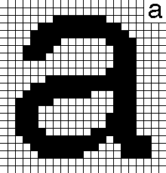

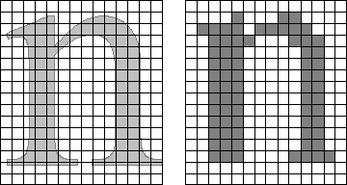
Introduction to Fonts - Bitmap
Bitmap fonts specify which pixels in the character are on or off
As a result, bitmap fonts are fixed in size, and not rescalable
While outline fonts are normally sized by points, bitmaps are often sized by pixels
A 23x22 bitmap character
A word in different bitmap sizes
Comparison: outline vs 14x16 bitmap

Slide 7
Including supplemental code
The #include statements we’ve used so far, at the beginning of our sketches, are how we have incorporated libraries into our sketches
However, it’s easy to incorporate our own code in the same way
The IDE will search the same folder as the sketch for any files we include by using quotes “”. These so-called header files must have a suffix of .h
Important note: the .h is not used when specifying the file in the IDE!
The following statement will incorporate the code from the file myheaderfile.h into your sketch:
#include “myheaderfile”

Slide 8
Classroom Exercise Using Different Fonts
Load SKETCH12B
There are a number of font header files in your SKETCH12B directory; have a look at their filenames in your file explorer.
Now modify your sketch to use a different font than the one already specified in SKETCH12B
#include <SPI.h>
#include <MD_MAX72xx.h>
#include <MD_Parola.h>
#include"Parola-boldFont.h"
...
pmx.setFont(parola_boldFont);
Note that the font header file begins with a capital “P” and the font name itself begins with a lowercase “p”!

Slide 9
MD Parola Display Zones
Normally, MD_Parola treats the entire display as a single display zone, numbered zone zero (0).
The number of 8x8 display modules contained in zone zero is specified by the MAX_DISPLAYS definition at the beginnging of your sketches
However, with Parola it is possible to break up a series of MAX7219 8x8 LED matrix displays into multiple zones.
This allows completely different data, fonts, and event text effects to be applied to different areas of a display

Slide 10
Classroom Exercise Using Multiple Display Zones
Let’s see how that works! Load SKETCH12C
Notice the section of code where the different zones are defined
Now modify your code as follows:
Apply different fonts to each zone
Change the entry and exit effects for each zone
void setup()
{
// put your setup code here, to run once:
pmx.begin(2);
pmx.setZone(0,0,1);
pmx.setZone(1,2,3);
pmx.setZoneEffect(0, true, PA_FLIP_LR);
pmx.setZoneEffect(0, true, PA_FLIP_UD);
pmx.setZoneEffect(1, true, PA_FLIP_LR);
pmx.setZoneEffect(1, true, PA_FLIP_UD);
pmx.setFont(1,parola_boldFont);
}
void loop()
{
if(pmx.displayAnimate())
{
pmx.displayZoneText(0,"SEICHE",PA_CENTER,50,0,PA_SCROLL_RIGHT,PA_SCROLL_RIGHT);
pmx.displayZoneText(1,"2022",PA_CENTER,50,0,PA_SCROLL_LEFT,PA_SCROLL_LEFT);
}
}

Slide 11
END OF AUTUMN SEMESTER END OF BASIC ARDUINO PROGRAMMING!
NO HOMEWORK ☺
IF YOU ARE NOT RETURNING NEXT SEMESTER, KEEP YOUR USB DRIVES and DISPLAYS!
IF YOU ARE RETURNING, PLEASE RETURN YOUR USB DRIVES
YOU MAY KEEP YOUR DISPLAYS OVER BREAK
Be sure to tune in for Intermediate Programming next semester!
Creating bitmap fonts
Accessing information on the global Internet
Serving web pages with ESP8266
Network communication with ESP8266 and MQTT

Slide 12
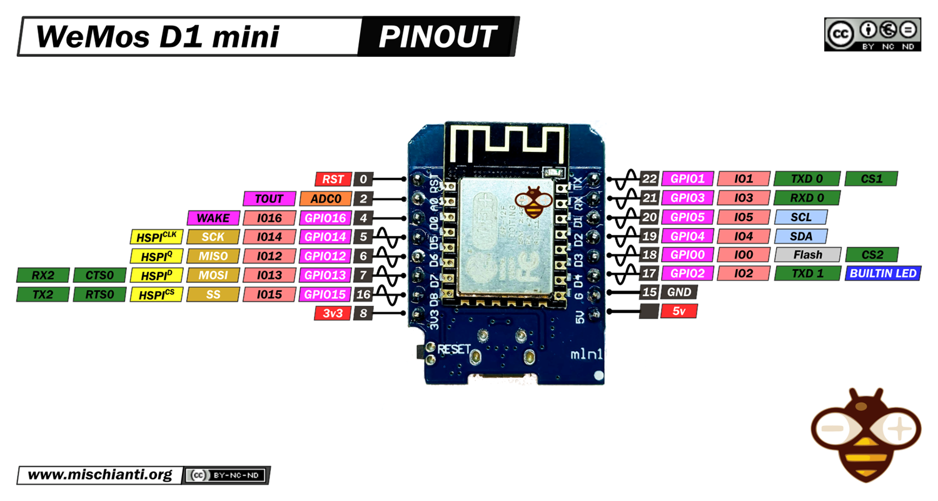
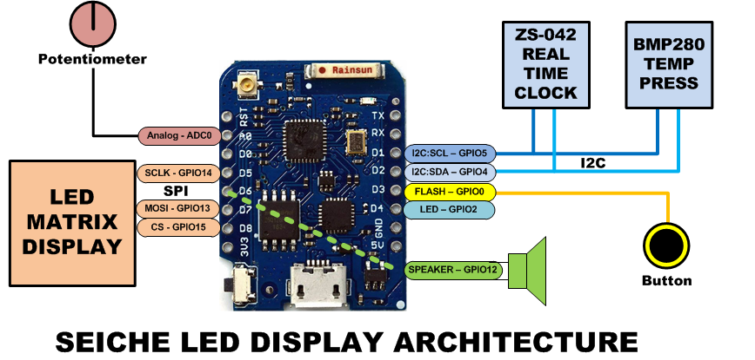
LESSON REFERENCE

Slide 13
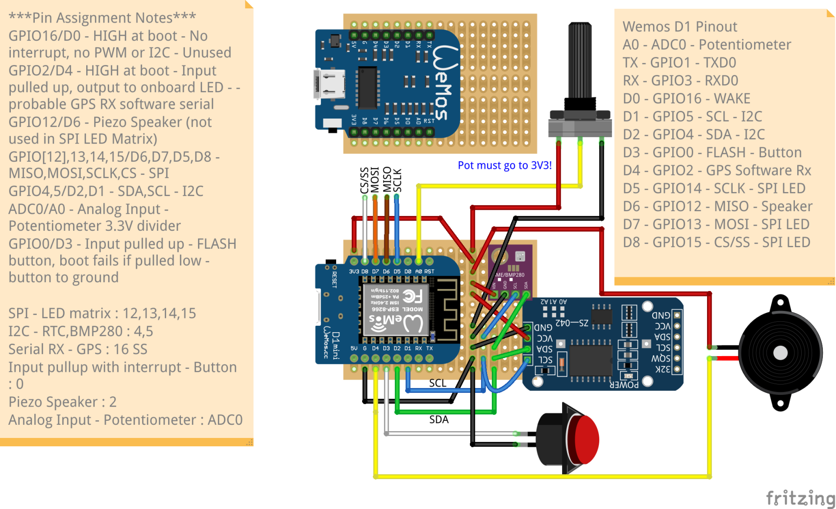
LESSON REFERENCE

Slide 14
sprintf() Format Strings
sprintf() format strings contain conversion specifiers that specify how each individual variable is to be converted
sprintf() conversion specifiers have the following general syntax (all begin with a percent-sign):
%[flags][minimum field width][.][precision][length][conversion character]
% - special token that indicates the start of a conversion specifier
Flags – these modify the behavior of the specification
Minumum field width – as it says on the tin; this the minimum number of characters to be converted
. – The period is a separator between field width and precision
Precision – means one of the following depending on the variable type and conversion specifier
The maximum number of characters to be generated from a string
The number of digits after the decimal point for type float conversions (e, E, or f)
The zero-filled minimum number of digits for an integer
Conversion character – A single character which determines the output type of the conversion specifier; a single character that specifies the type of output format for the corresponding data or variable

Slide 15
sprintf() Conversion Specifiers
Below are the general conversion specifiers and what they do.
Specifier | What it does
d, i | int - integer; signed decimal notation
o | int – unsigned octal (no leading zero)
x, X | int – unsigned hexadecimal, no leading 0x
u | int – unsigned decimal
c | int – single character, after conversion to unsigned char
s | char * - characters from string are printed until \0 (NULL) or precision is reached
f | double – decimal notation of form [-]mmm.ddd where number of decimals is specified by precision; precision of zero (0) suppresses the decimals altogether
e, E | double - exp notation; default precision of 6, 0 suppresses
g, G | double – Use %f for <10^4 or %e for >10^4
p | void * - print output as a pointer, platform dependent
n | Number of characters generated so far; goes into output
% | No conversion, put a % percent sign in the output

Slide 16
sprintf() Conversion Specifiers
Below are the flags and what they do.
Flag | What it does
- | Left justification
+ | Always print number with a sign
spc (space) | Prefix a space if first character is not a sign
0 (zero) | Zero fill left for numeric conversions
# | Alternate output form depending on conversion character o – first digit will be zero x or X – 0x or 0X (respectively) prefixed to non-zero results e, E, f, g and G – Output will always have a decimal point g and G – trailing zeroes will never be removed

